Slide 1


Analysis of Cricket Match
Sreekar Kairika
Tharun Kumar Reddy Tummala

Slide 2
Introduction
Cricket is a highly popular sport around the world. It generates vast data during matches, including player statistics, ball-by-ball details, weather conditions, and historical performance metrics.
Analyzing this data comprehensively can provide valuable insights for teams, players, and enthusiasts.
Traditional methods of cricket analysis often need to catch up in handling the sheer volume and complexity of this data. Therefore, we are trying to build a robust and scalable cricket match analysis platform.

Slide 3
Existing and Proposed Systems
Traditional cricket analysis often relied on manual data collection and simple statistical methods, limiting the depth and scalability of insights.
However, with the integration of advanced data analytics, big data technologies like Google Cloud Platform (GCP), and PySpark, we can now process and analyze large volumes of cricket data in real-time, providing teams and analysts with more detailed, actionable insights

Slide 4

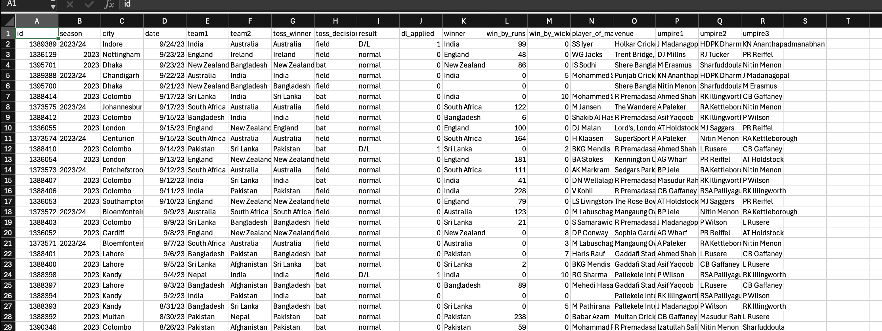



Data Set
We have taken multiple datasets from Kaggle
We have a summary of match details from 2003 to 2024
We have detailed ball-by-ball of every match

Slide 5
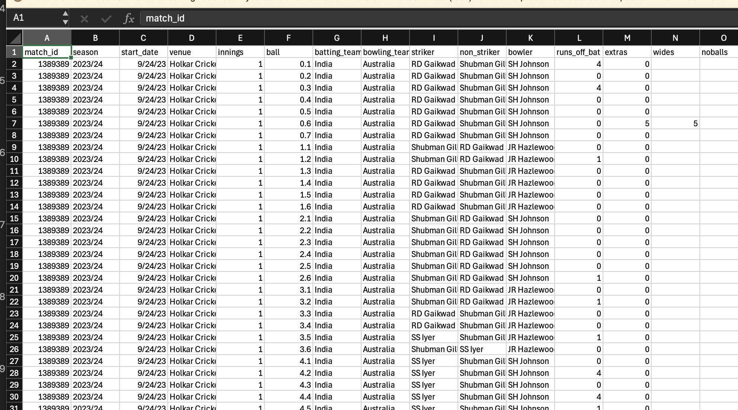
Data Set

Slide 6
Tools & Technologies Used
Google Cloud Platform(GCP)
Google Cloud DataProc
Python
Jupyter Notebook
PySpark SQL
Spark

Slide 7
Tools & Technologies Used
GCP (Google Cloud Platform): A flexible and user-friendly cloud service where you only pay for what you use. It provides the necessary infrastructure to run your big data projects without worrying about hardware.
Google Cloud Dataproc: This service helps you easily create clusters for big data processing using tools like Apache Spark and Hadoop. It’s great for quickly scaling up or down, depending on the size of your data.
Python: A versatile programming language that’s perfect for analyzing data, cleaning messy datasets, and creating stunning visualizations to understand trends and patterns in cricket matches.

Slide 8
Tools & Technologies Used
Jupyter Notebook: A web-based tool that we’re using on GCP. It’s like an interactive playground for coding, allowing us to write, test, and share Python code for our analysis.
Spark: A powerful engine for processing large datasets quickly, making it possible to analyze the performance of players and matches efficiently.
PySpark SQL: A feature of PySpark that lets us work with structured data using SQL-like queries. It’s super useful for organizing and analyzing the match data stored in tables or structured formats.

Slide 9
Development Flow
Dataproc Cluster Creation
Starting a Spark session
Data Cleaning
Data Analysis
Data Visualization
Creating Bucket

Slide 10
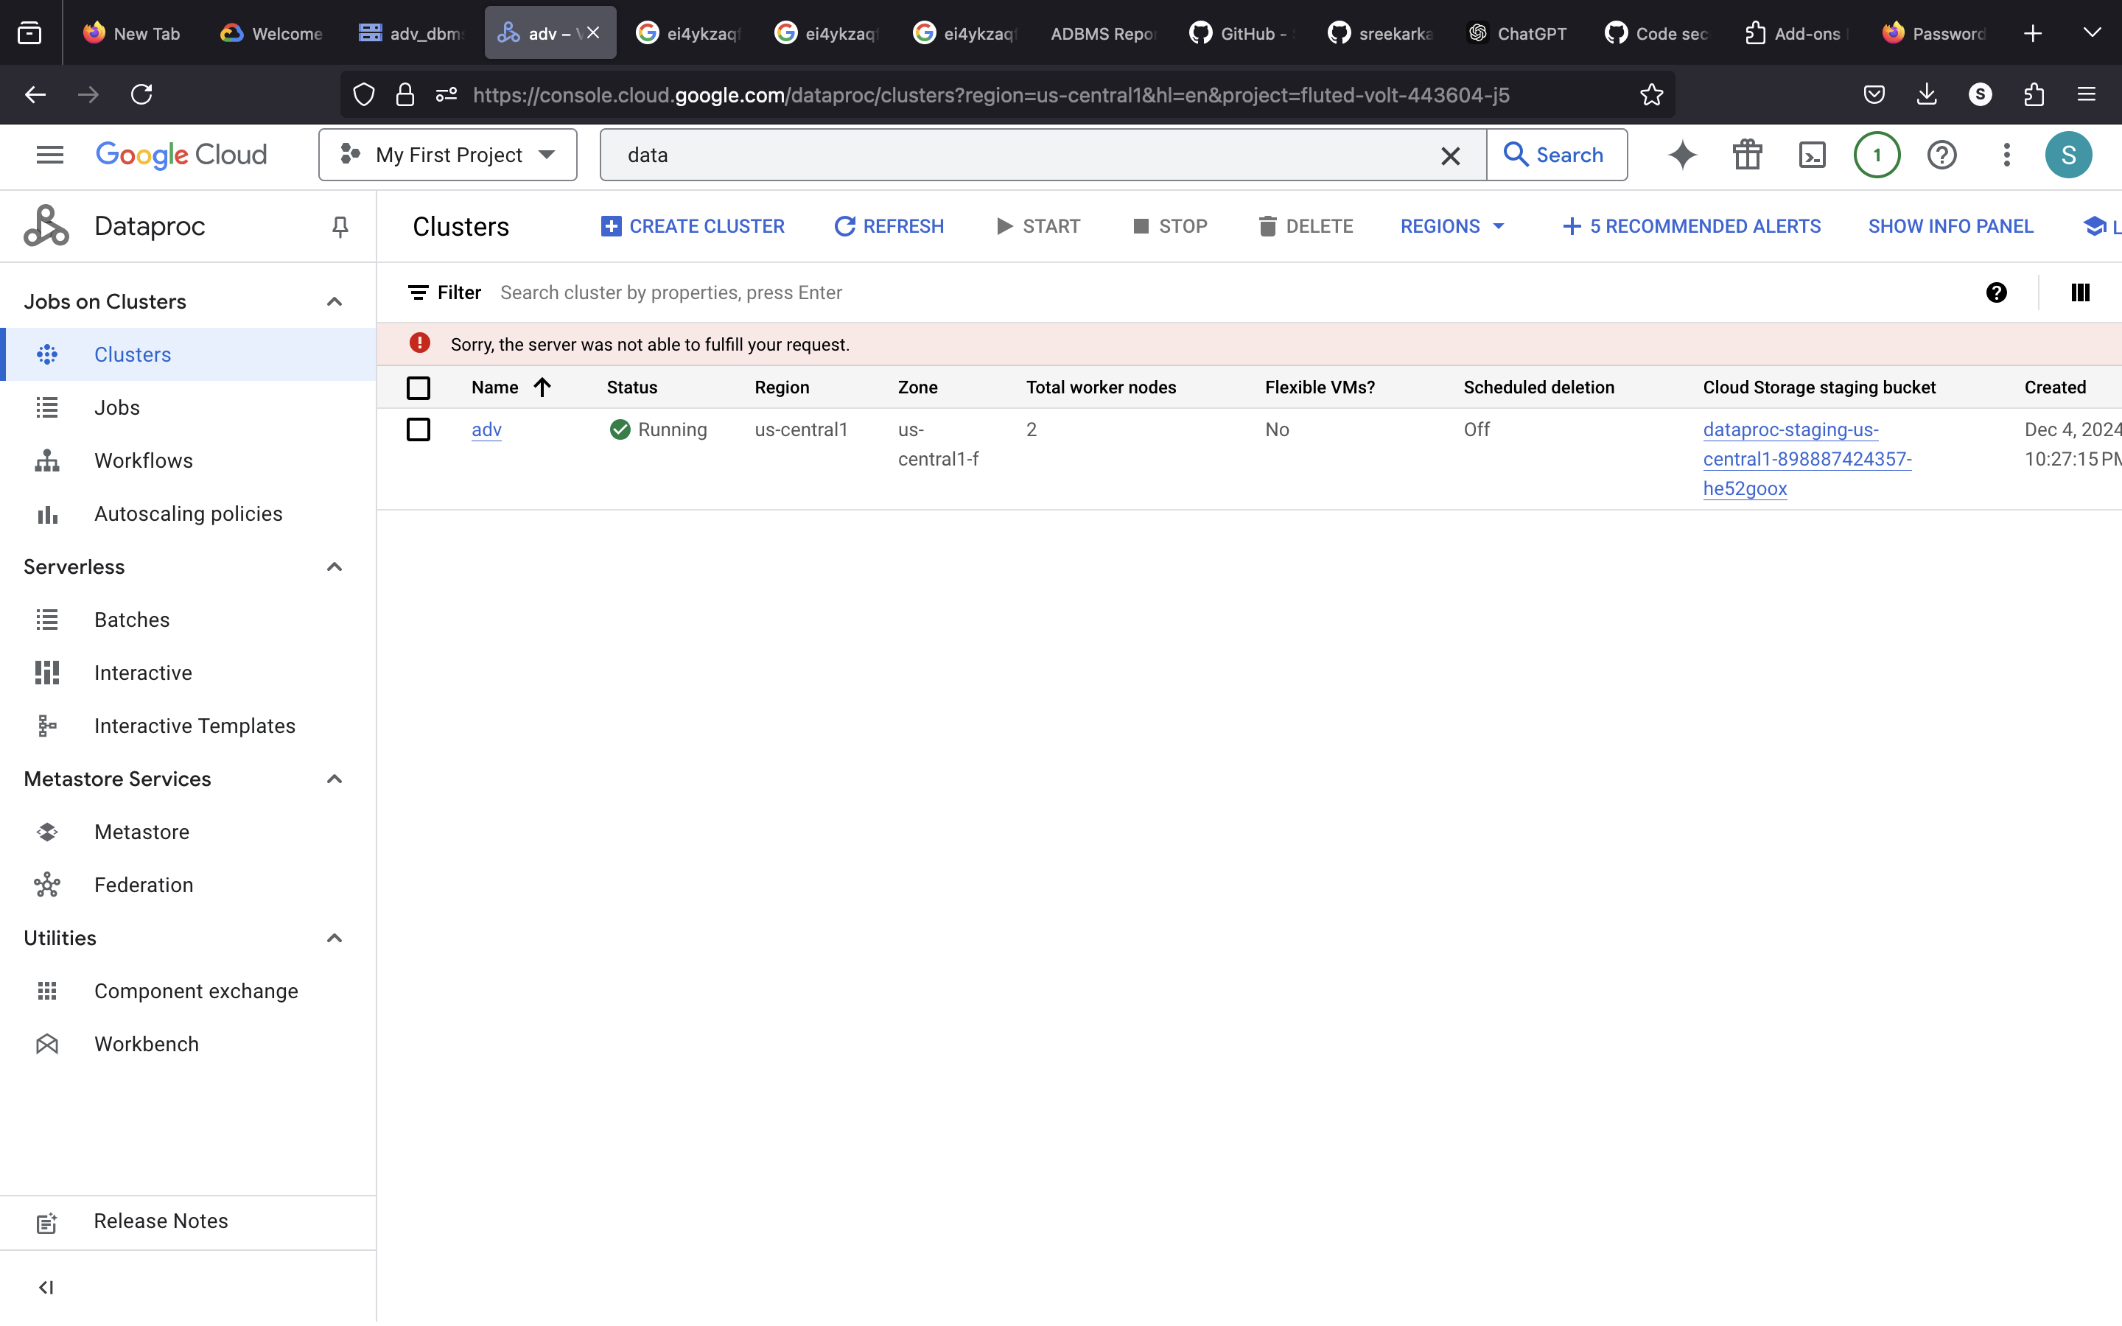
Cluster Creation
Google Dataproc is a managed service for creating, managing, and scaling clusters to efficiently process and analyze big data.
The cluster consists of a master node that manages the cluster and distributes tasks, and worker nodes perform data processing tasks. These nodes work together to handle your data efficiently.

Slide 11
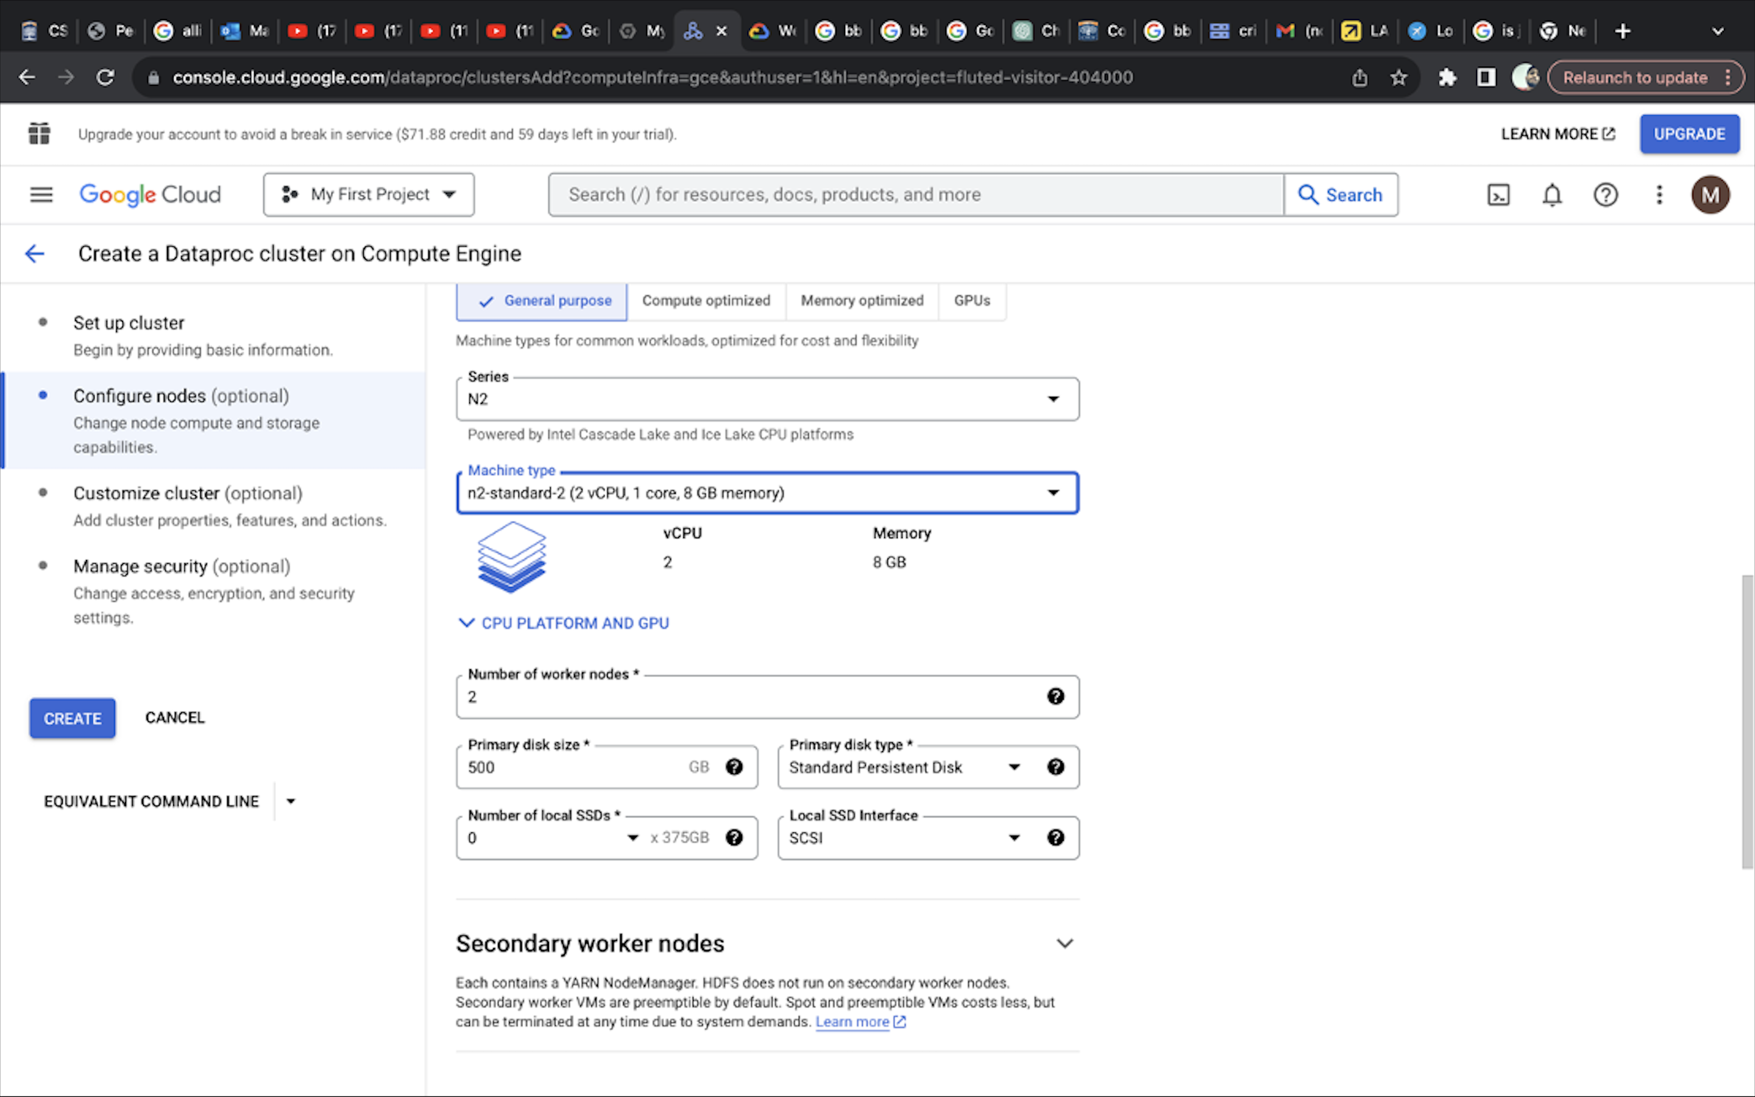
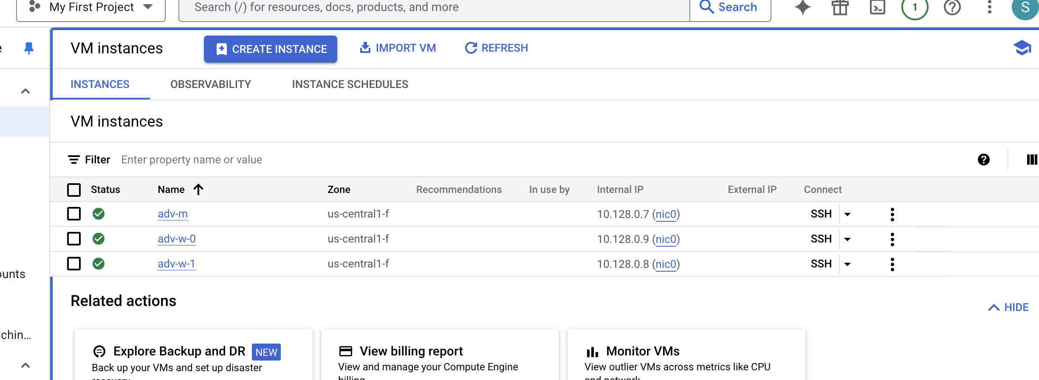
Cluster Creation
Dataproc clusters use virtual machines (VMs) that can be fully configured and customized to meet workload needs.

Slide 12
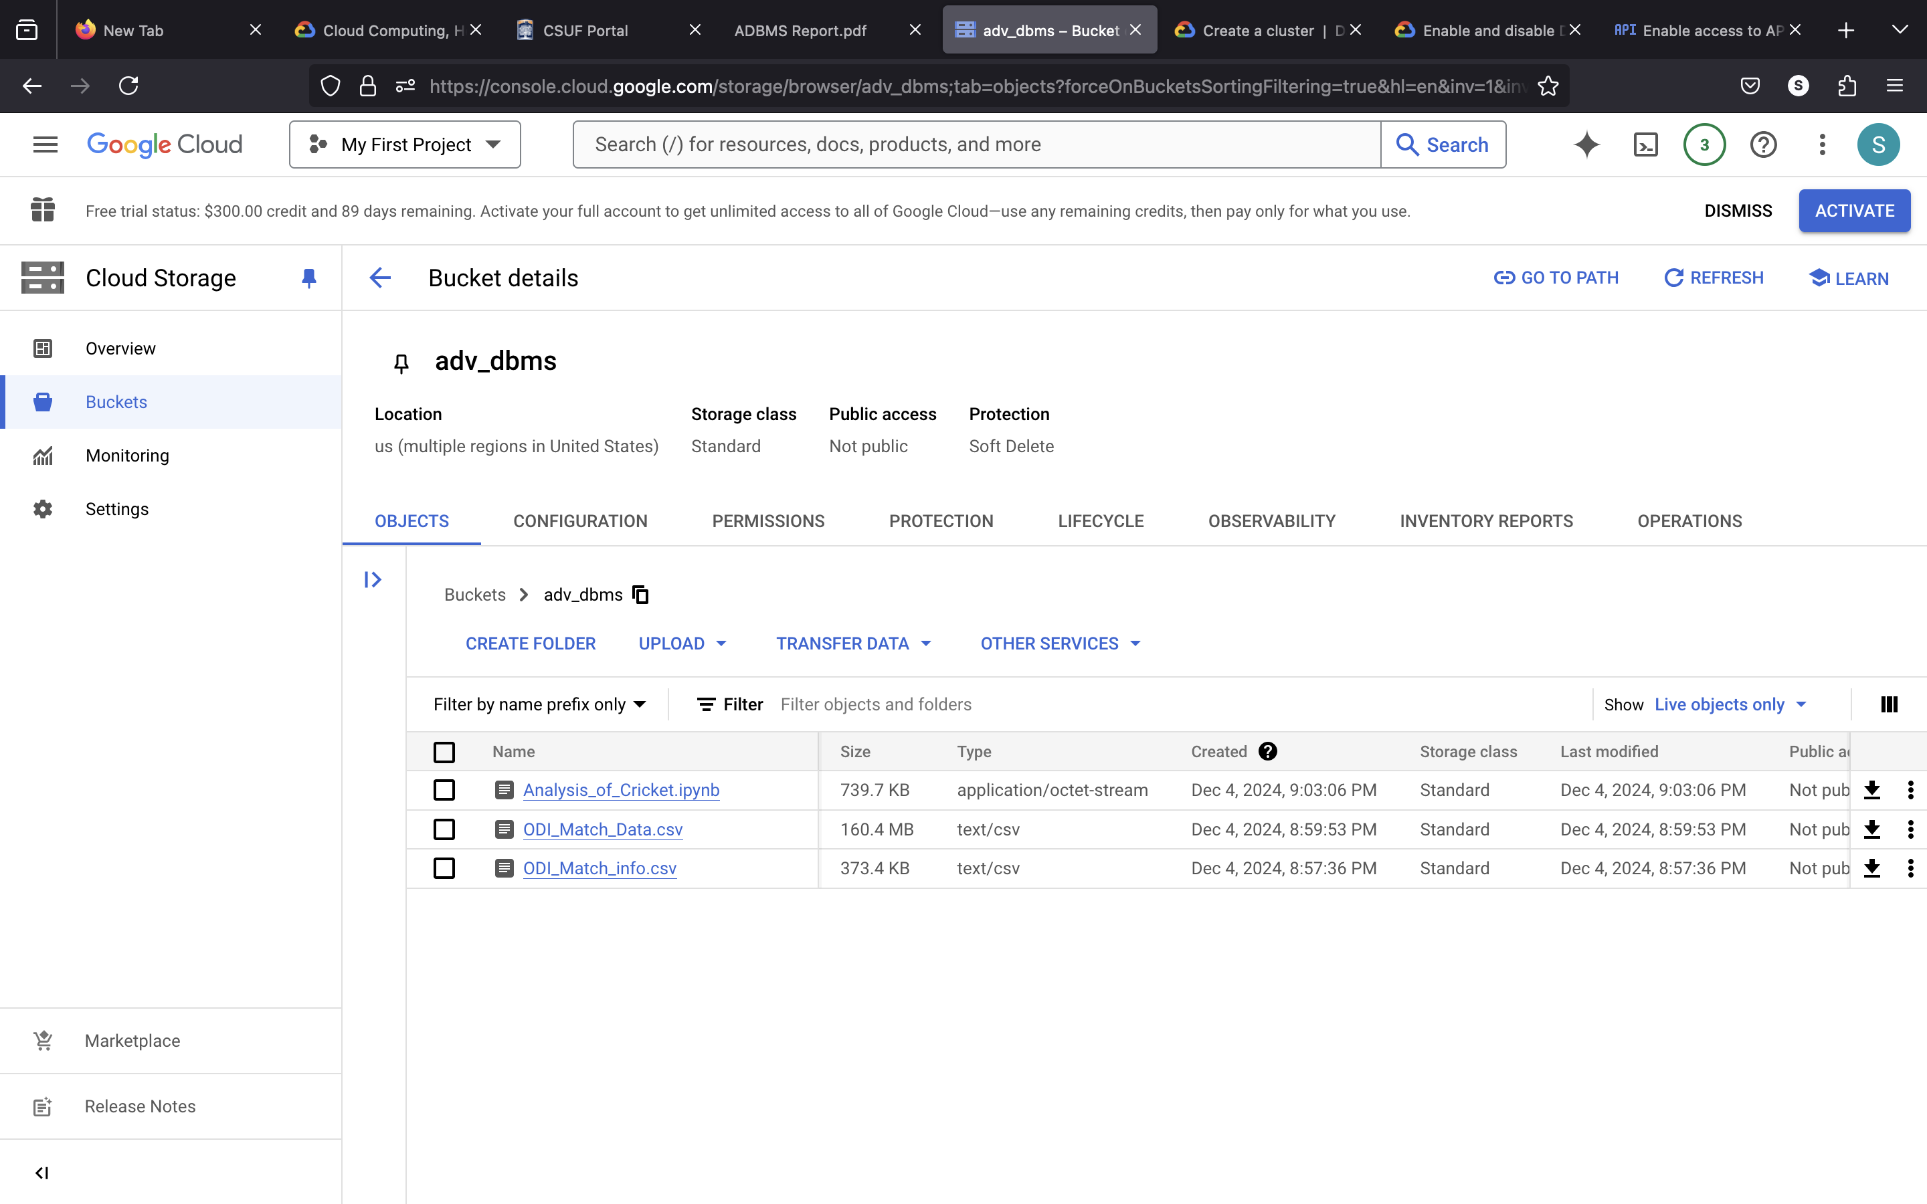
Bucket Creation
Data buckets are storage spaces used to organize and manage data in the cloud.
Spark sessions in a Dataproc cluster can directly read data from and write data to Google Cloud Storage bucket.

Slide 13
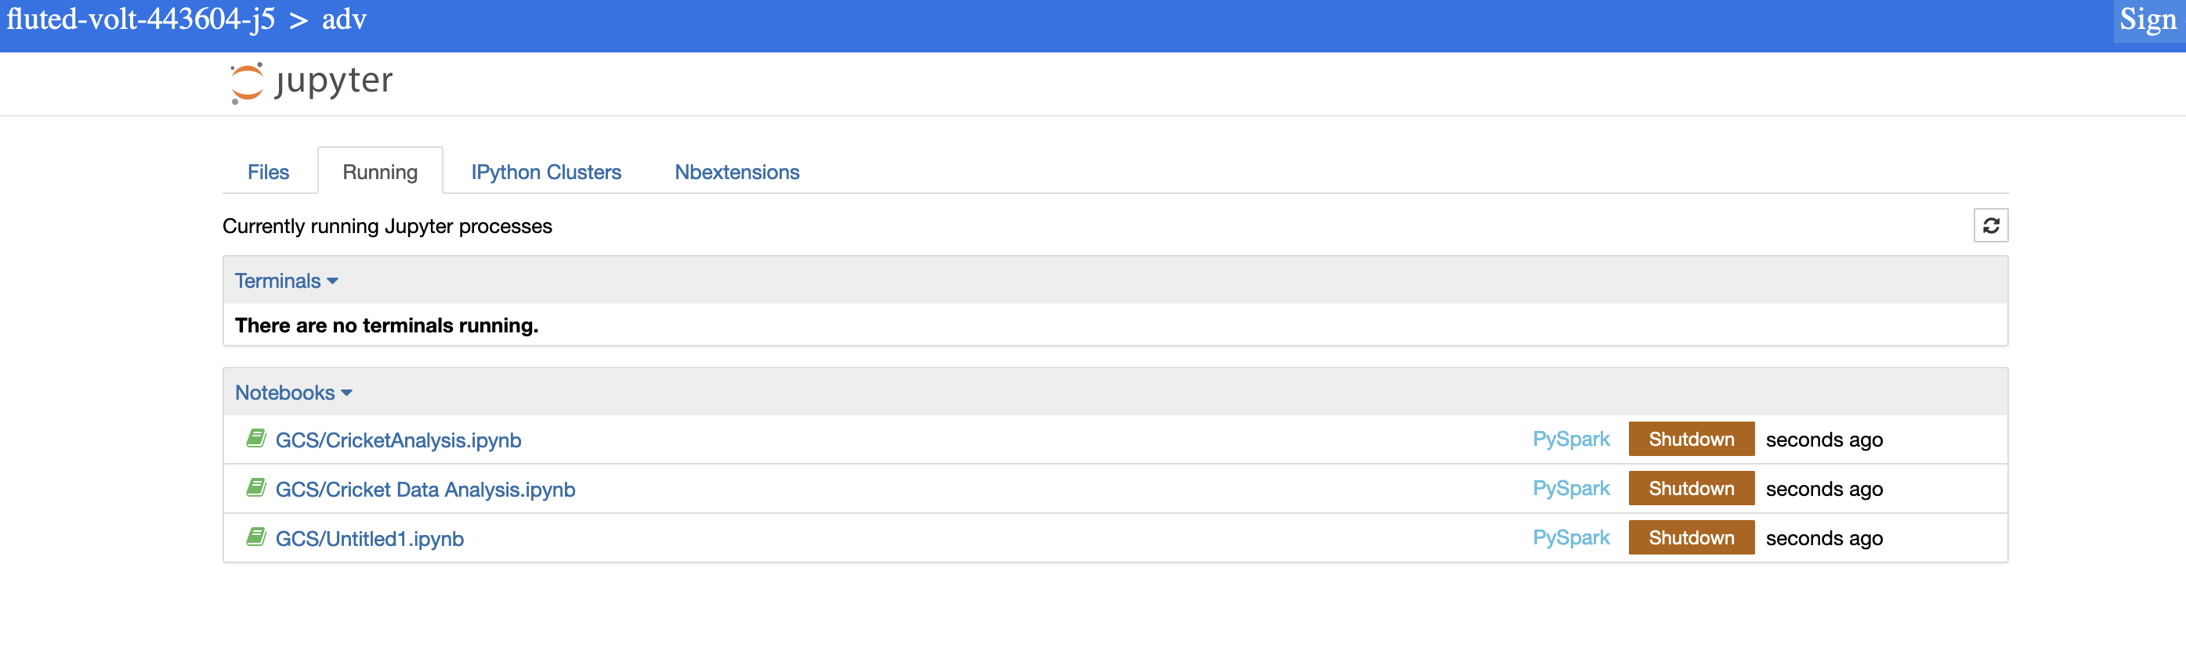
Spark and Jupyter Notebook
Dataproc virtual machines come pre-installed with Spark and Jupyter Notebook, providing an interactive environment for data analysis.
Jupyter Notebook can be easily started through Dataproc, allowing users to write and execute Spark code in a web-based interface.
This setup enhances data processing by enabling real-time data exploration, visualization, and machine learning model development within Spark.

Slide 14
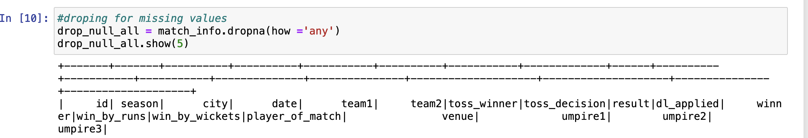
Data Cleaning
Data cleaning techniques can be applied to address inconsistent values, handle missing values, ensure consistent formatting.
Data Imputation: Data imputation is a data cleaning technique where missing values are either dropped or replaced with estimated values like mean, median, or predictions.

Slide 15
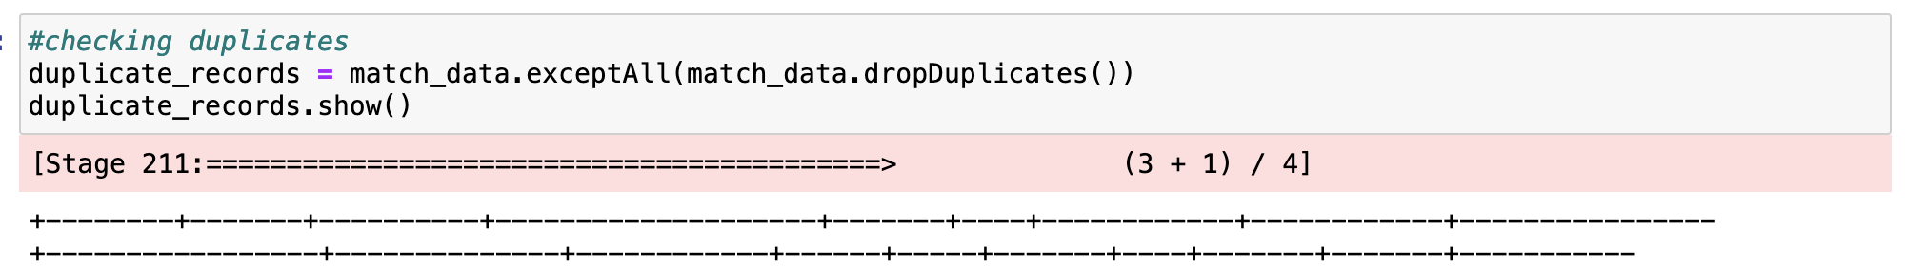
Data Cleaning
Removing duplicates is a data cleaning process that eliminates identical or redundant records from a dataset to maintain data accuracy and integrity.
Consistent formatting ensures that all data in a dataset follows a uniform structure, making it easier to analyze, process, and maintain.

Slide 16
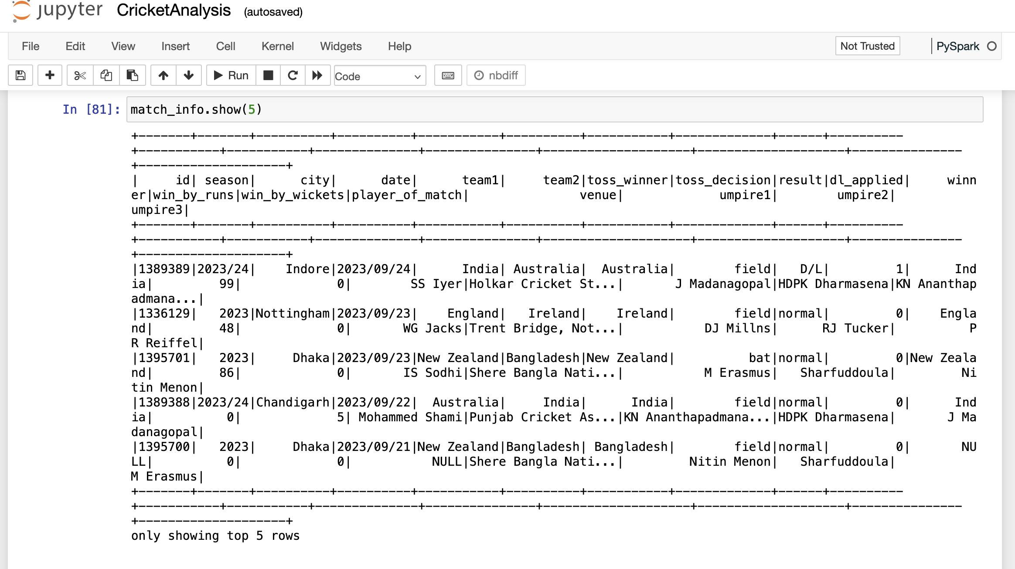
Data Analysis

Slide 17
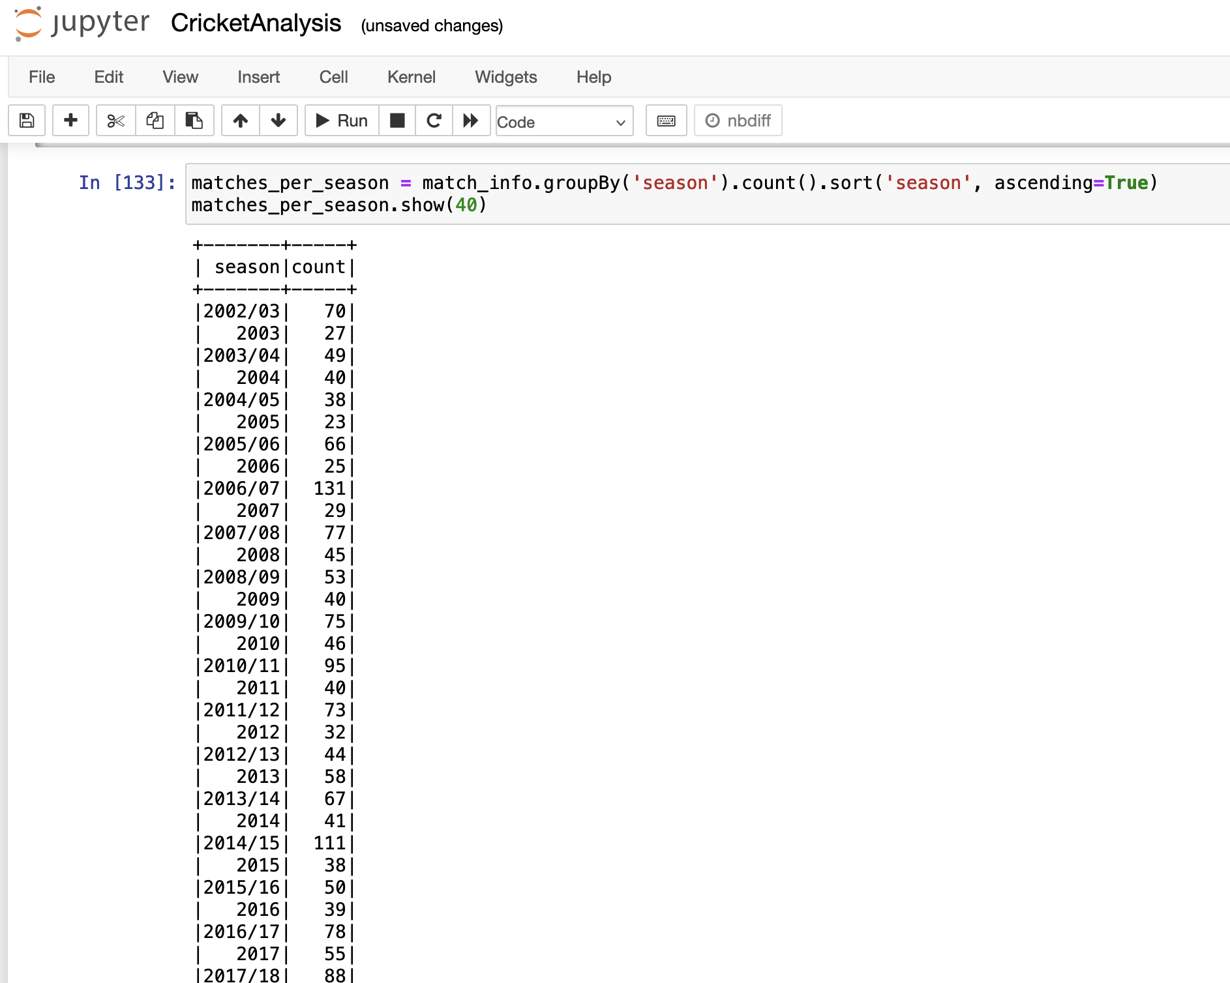
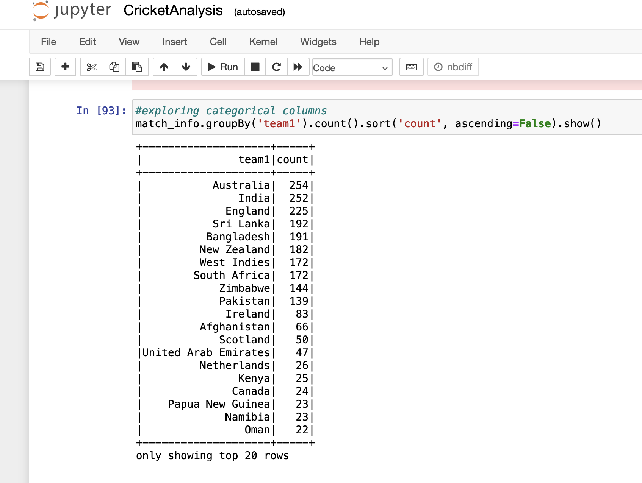
Data Analysis

Slide 18
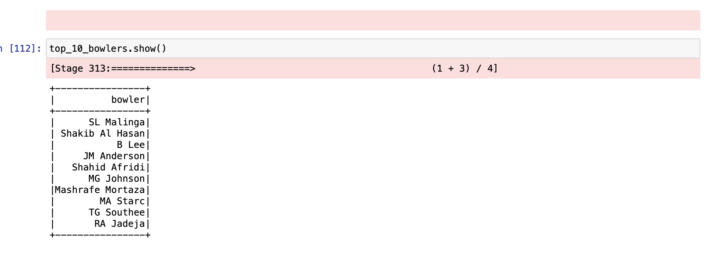
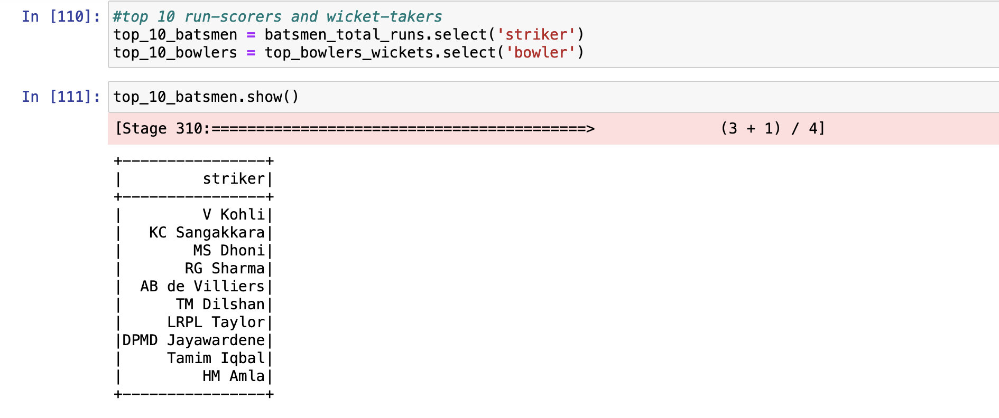
Data Analysis

Slide 19
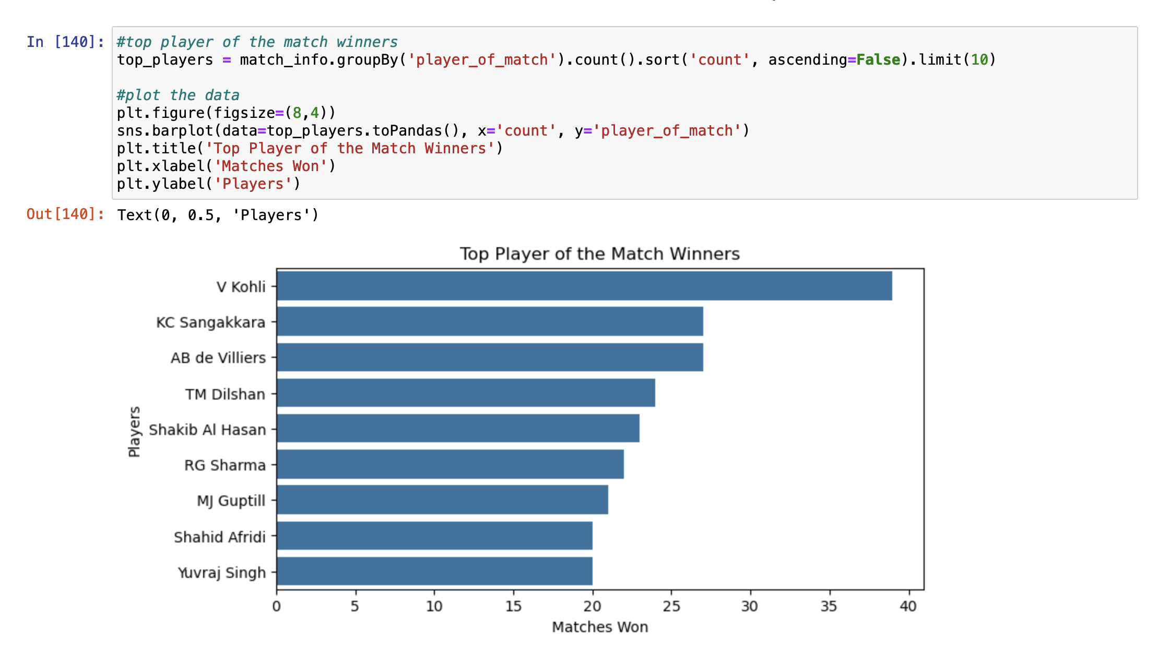
Data Visualisation

Slide 20
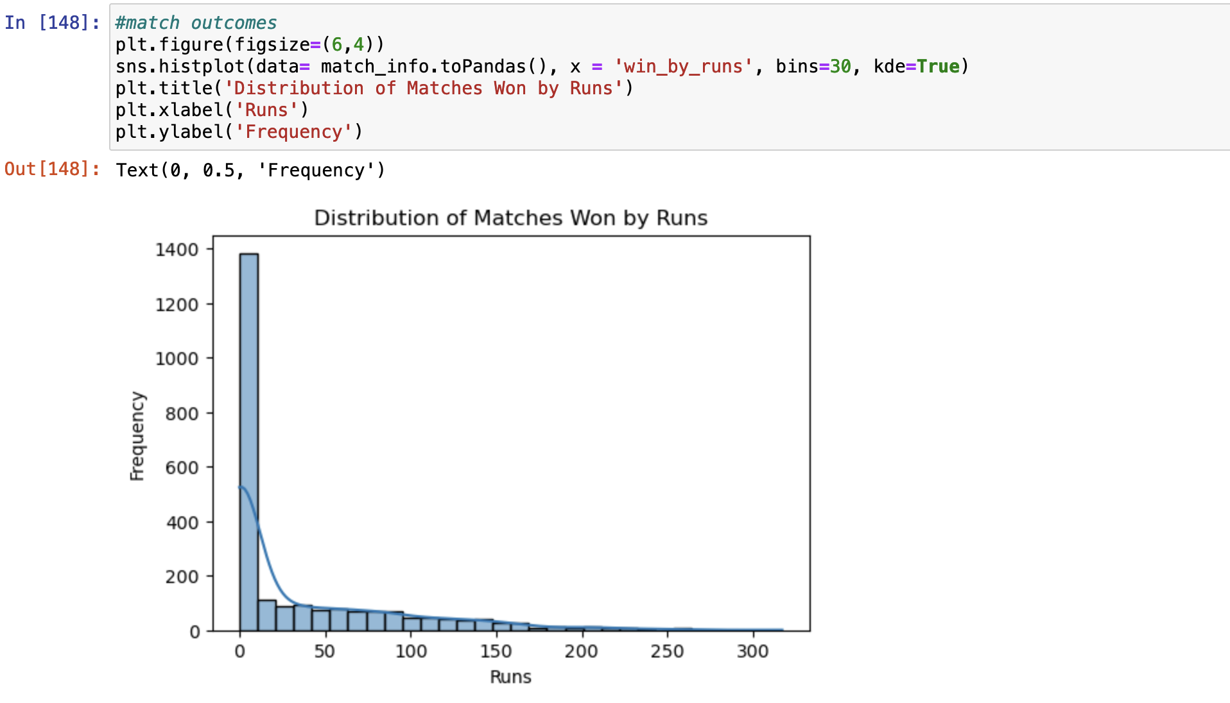
Data Visualisation

Slide 21
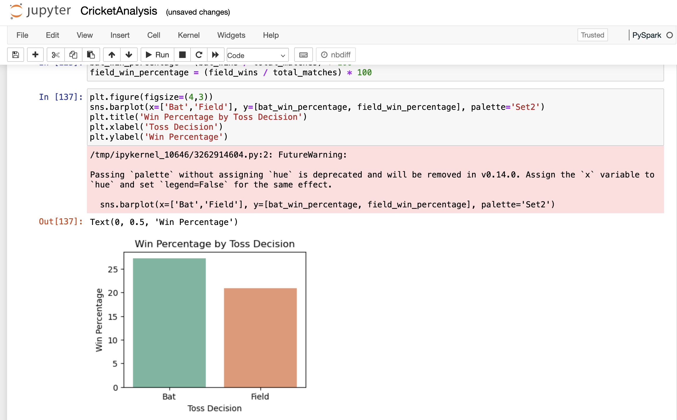
Data Visualisation

Slide 22
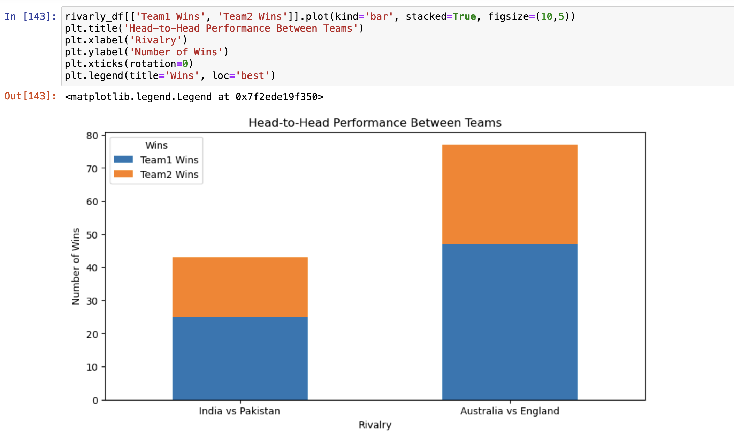
Data Visualisation

Slide 23
Benefit to the cricket industry
Team Strategies and Game Planning
Player Performance Analysis
Player Scouting

Slide 24
Any Questions?

Slide 25
Thank You

